Slide 1
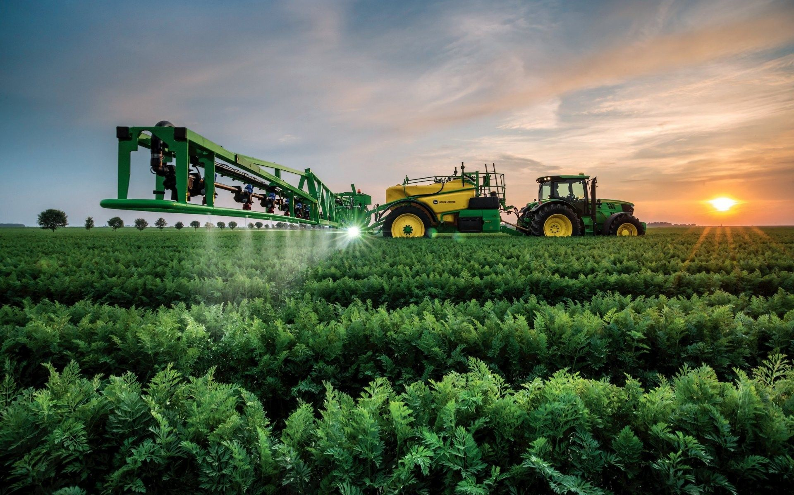

FARMING EQUIPMENT RENTAL SERVICES

Slide 2
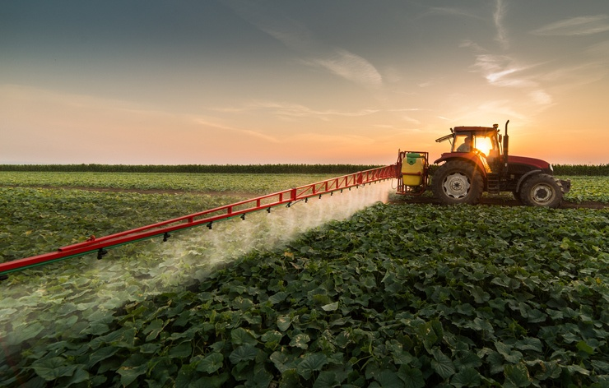
PROBLEM STATEMENT:
A mobile application that the farmers can use to hire tractors as well as other mechanizations at a nominal amount all using their mobile phones. This would not only help them avoid manual labour but can be also be considered as an important step to encourage this profession.

Slide 3



SOLUTION:
We are proposing an app that directly connects farmers who want to hire farming mechanizations like tractors, irrigation pump set, etc with the people nearby who have put farming mechanizations on rent on our app.

Slide 4
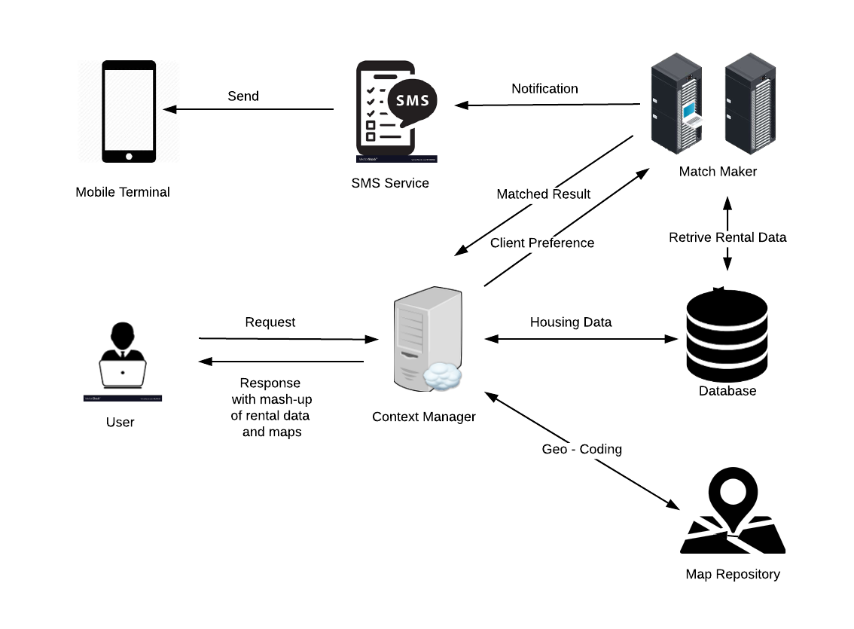
ARCHITECTURE:

Slide 5
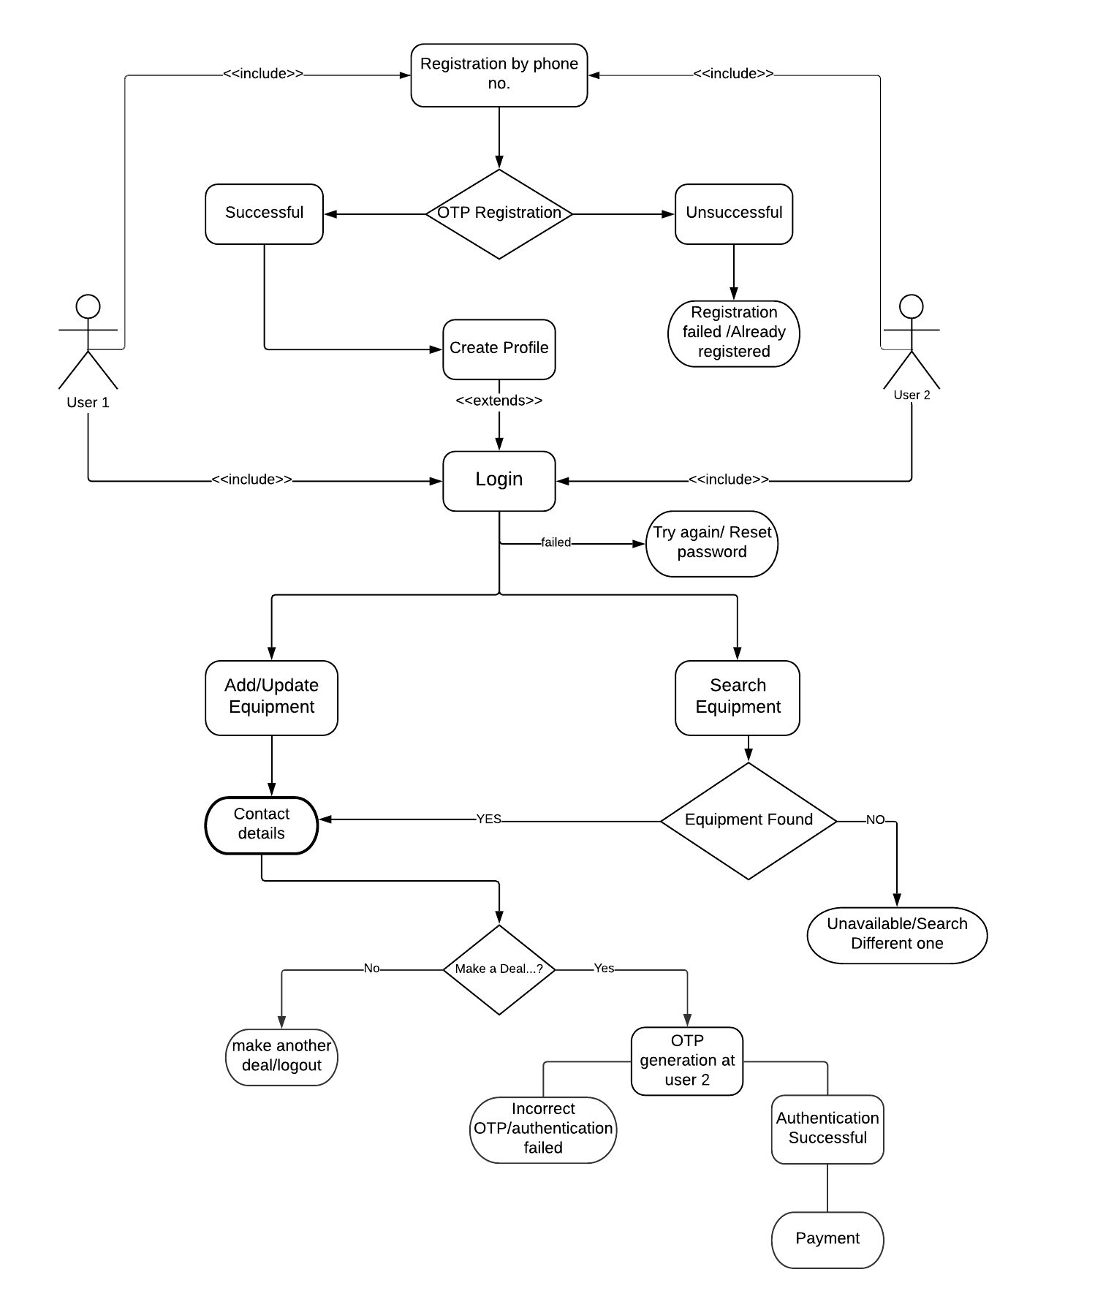

Slide 6
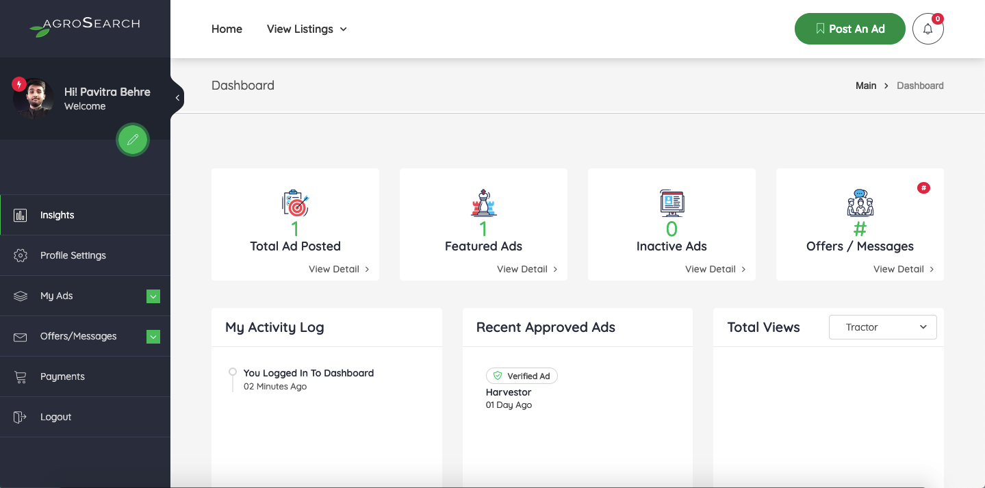
FEATURES:

Slide 7

HOME 1:

Slide 8
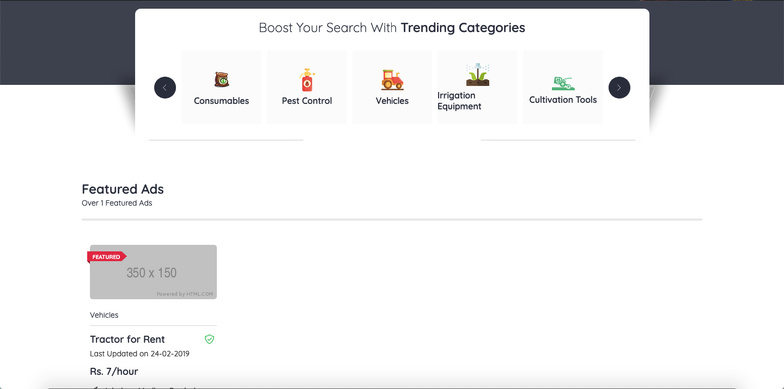
HOME 2:

Slide 9
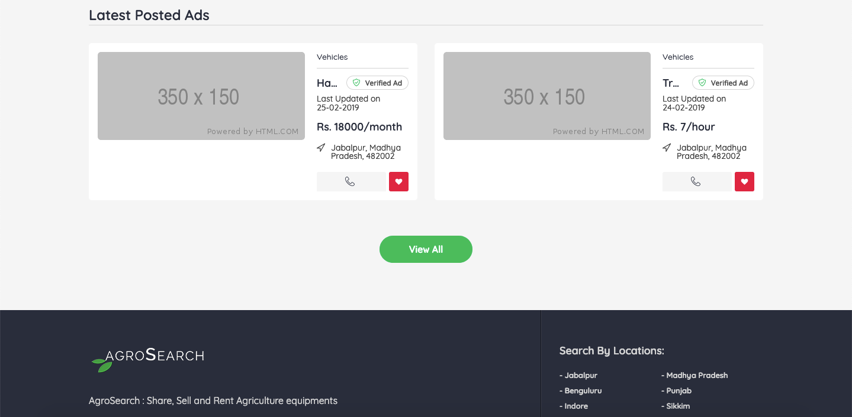
HOME 3:

Slide 10
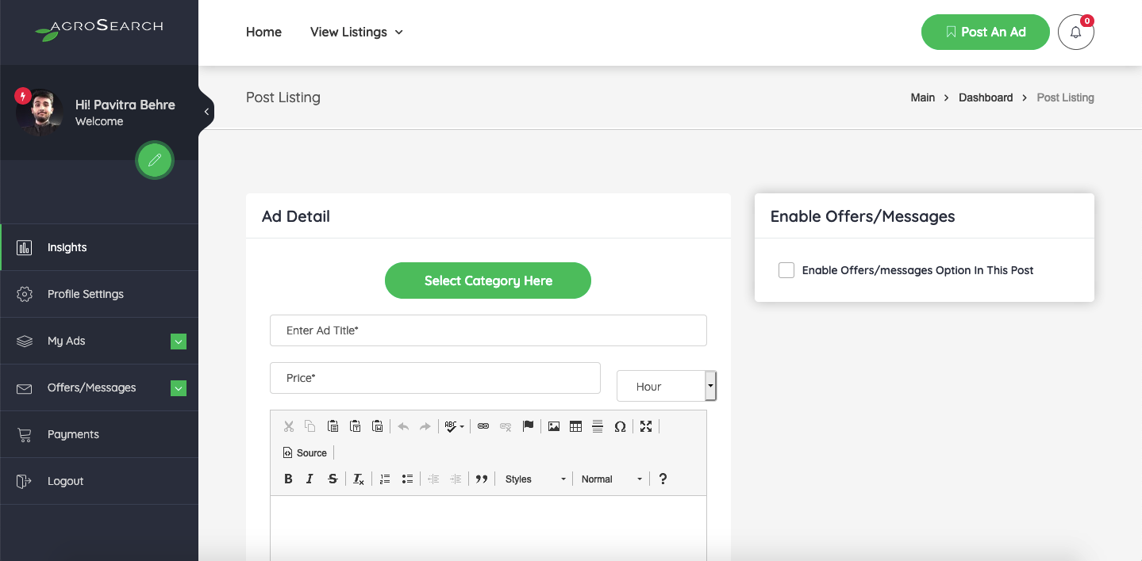
POST 1:

Slide 11
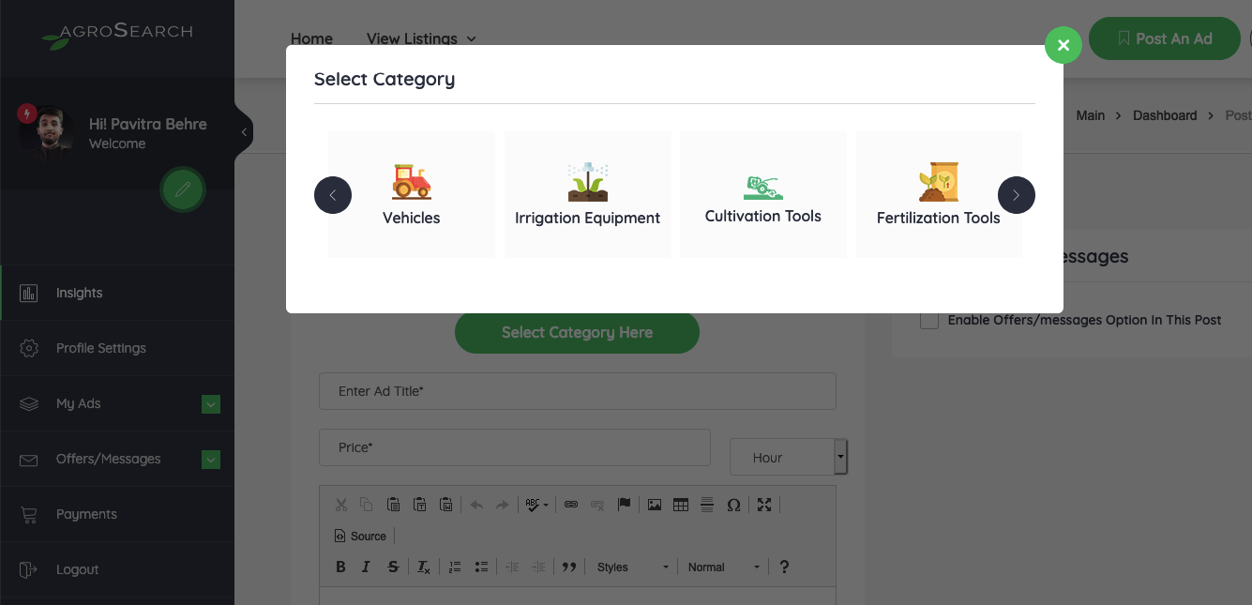
POST 2:

Slide 12
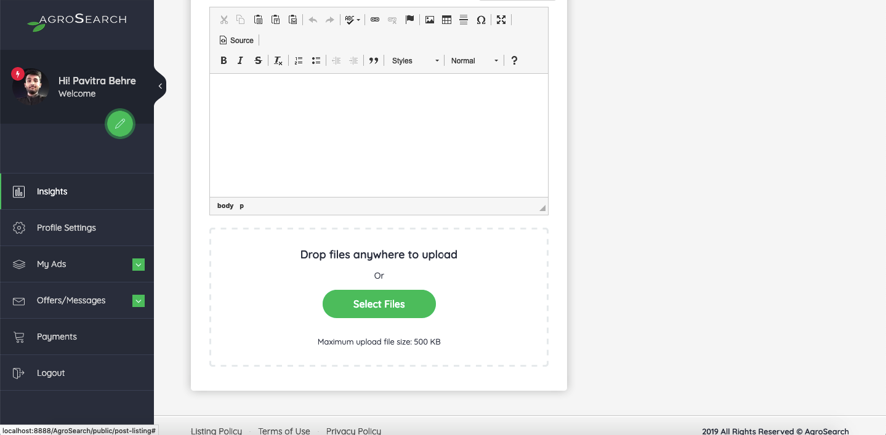
POST 3:

Slide 13
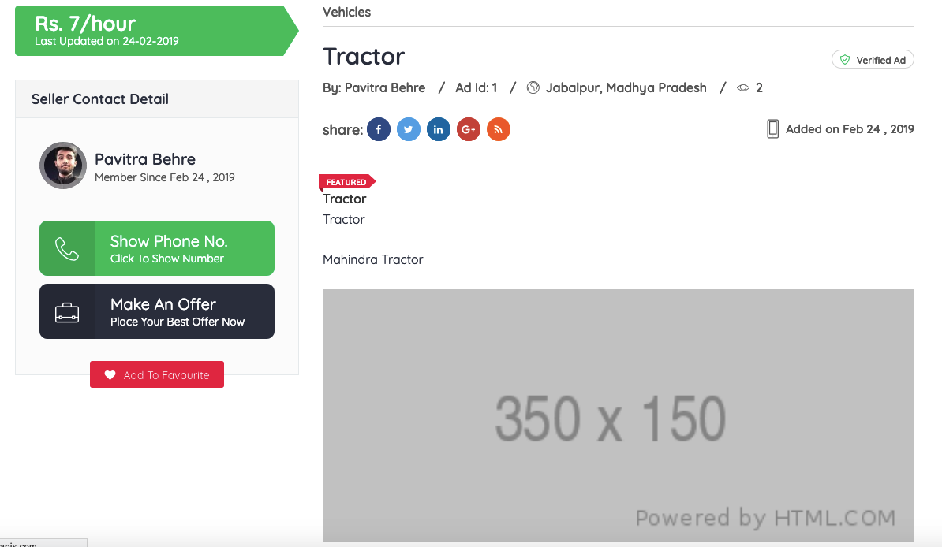
LISTING DETAILS:

